Slide 1
InternshipFinder
By:
Efaz Khan
Rachid Bodson
Rachel Abraham

Slide 2
Introduction:
Our database is an internship finder
This would allow for students to be able to find internships faster and more efficiently
This would also allow companies to find interns faster
The internship finder would be populated with several different internship opportunities
Students would then be able to apply to these internships or save these applications for later

Slide 3
Introduction:
Aspects of the mini world
Minimizes the struggle of going through several different websites to find internships and keeping track of them
Our database only focuses on internships, so students do not have to filter through other types of jobs

Slide 4
Requirements Analysis
We required information on several different companies (such as the names, locations, types of internships offered etc...) to establish a relationship between the company and the students
We also required information on the students through the form of creating an account
The information on the company and the students was helped to keep track of what internships were being offered at a company as well as what types of internships students were applying for

Slide 5
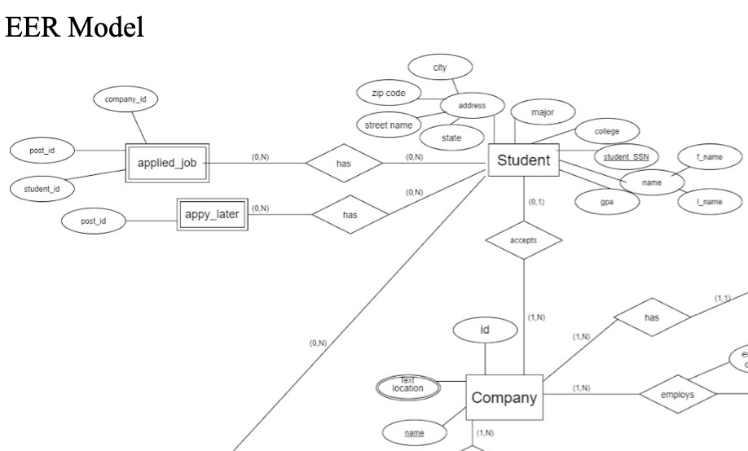
ER design
Some of the important aspects of the ER diagram include the students, companies and the jobs applied and the relationships between them. We deemed this as the important aspect in our database because that is the objective of the database, students being interested in a company and vise-versa

Slide 6
Data
Company and Internship Postings:
We used LinkedIn and Indeed APIs to get all the company information including job posts and the urls.
Student Data:
The Student data was populated with dataset we created ourselves.
The student entities were filled with information about the education of the student such as their major and their GPA

Slide 7
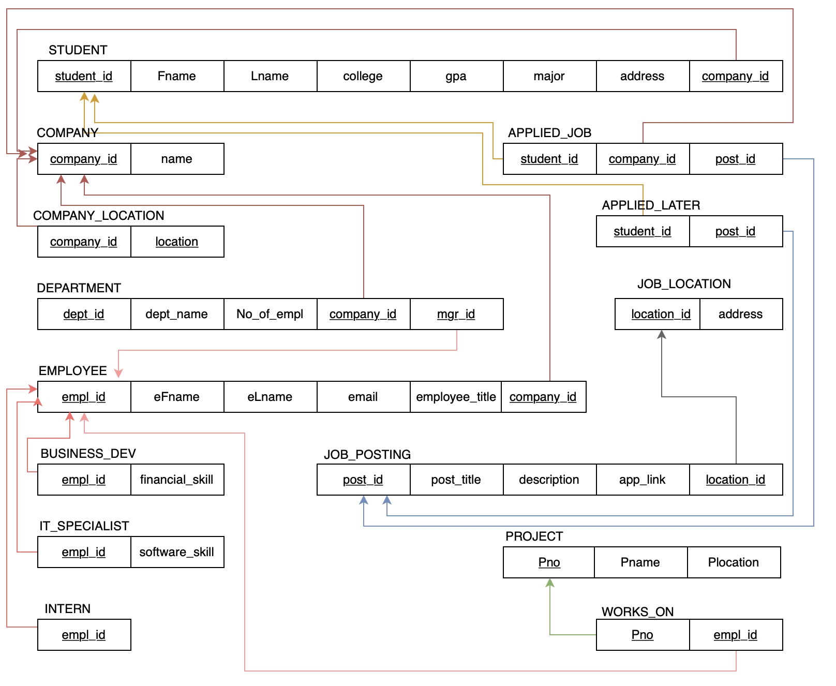
Relational Model
To obtain the relational model, we mapped our er diagram following the necessary steps for mapping er to relational model with emphasis on the cardinalities.

Slide 8

Relational Model cont...
After mapping the er into relational model, we noticed that the relation schema seems to be in a second normal form(2NF) as all the non-attributes in the schema are fully functionally dependent on the primary key. For instance , for the relation schema DEPARTMENT
We have the list of the functional dependency :
{dept_id}--->{ dept_name, No_of_empl}
{dept_id, company_id}--->{mgr_id}

Slide 9

Relational Model cont...
However, since our goal is to have it in 3NF, we decomposed the schema into 3NF through the process of 3NF normalization which involves having a 2NF and a transitive functional dependency. The schema was already in 3NF because we have a candidate key, therefore, transitive functional dependency exists in the schema.
For instance, for the schema JOB_POSTING:
{post_id}--->{post_title}--->{description}
with post_id being the primary key and post_title being the candidate key

Slide 10
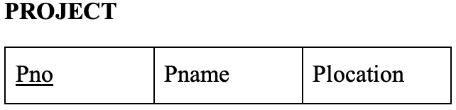
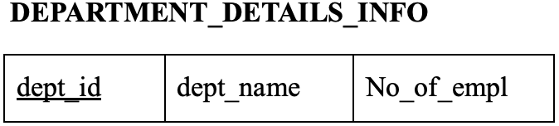
Relational Model cont...
Some more 3NF tables:
{Pno}--->{Pname}--->{Plocation} with Pno(primary key), Pname(candidate key)
{dept_id}--->{dept_name}--->{No_of_empl} with dept_id(PK), dept_name(CK)

Slide 11
Functionalities
Some of the applied queries allowed admins to store the personal information of students as well as information on companies
We were able to retrieve external links to allows students access to the the websites where these internships where being posted
Internships can be filtered based off of major
Student are also able to view the projects that companies have descriptions of in the database so they will have a better idea of what projects they may work on
The InternshipFinder also had several functions that were analytical in nature

Slide 12
Functionalities
Analytical functions:
The internship find generated the number of applications submitted
It also generates a breakdown of the internships to see the number of applicants for each internship. This would allow for admins to see which internships were the most popular and allow them to add similar internships in the future
Admins can also see the breakdown of majors within the database and change the types of internships to properly suit the audience

Slide 13
Summary and Conclusion
The InternshipFinder is a useful tool for students who are currently looking for an internship
It is also useful for companies who are looking for interns
This allows for companies to quickly receive applications and allows students to view several different internship opportunities

